Slide 1
Chapters 4, 5 Conditionals and Fruitful Functions

Slide 2
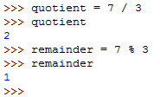
Modulus Operator
The modulus operator works on integers (and integer expressions) and yields the remainder when the first operand is divided by the second.
In Python, the modulus operator is a percent sign (%).
The syntax is the same as for other operators.
Check whether one number is divisible by another—if x % y is zero, then x is divisible by y.
Extract the right-most digit or digits from a number. x % 10 yields the right-most digit of x x % 100 yields the last two digits.

Slide 3
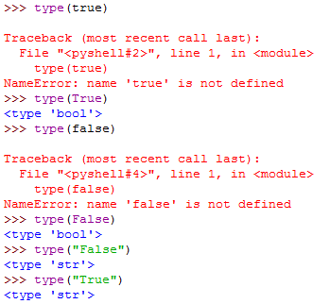
Boolean Expressions
A Boolean expression is an expression that is either TRUE or FALSE.
TRUE or FALSE are special values that are built into Python.
They belong to the type bool; they are not strings.

Slide 4
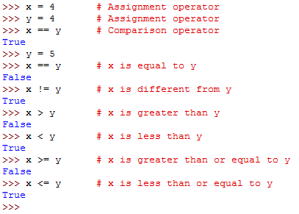
Comparison Operators
Comparison operator produce Boolean values.

Slide 5
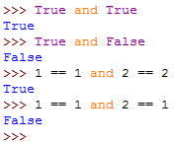
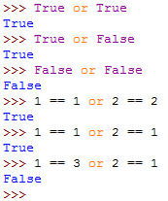
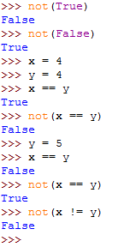
Logical Operators
Logical operators combine Boolean expressions.
There are three logical operators: and, or, and not.

Slide 6
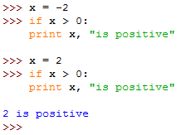
Conditional Statements
A conditional statement lets you execute parts of your code only when some condition is met.
The simplest form is the if statement.
if Boolean Expression: Statements
If is a keyword
The Boolean expression after the if statement is called the condition. If it is true, then the indented statement gets executed. If not, nothing happens.
if statements have the same structure as function definitions: a header followed by an indented body.
Statements like this are called compound statements.

Slide 7

If else Statement
A second form of the if statement is alternative execution, in which there are two possibilities and the condition determines which one gets executed. The syntax looks like this:
Since the condition must be true or false, exactly one of the alternatives will be executed.
The alternatives are called branches, because they are branches in the flow of execution.

Slide 8
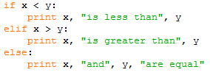
Chained Conditionals
Sometimes there are more than two possibilities and we need more than two branches. One way to express a computation like that is a chained conditional:
elif is an abbreviation of “else if”
There is no limit of the number of elif statements, but the last branch has to be an else statement.
Each condition is checked in order. If the first is false, the next is checked, and so on.
If one of them is true, the corresponding branch executes, and the statement ends.
Even if more than one condition is true, only the first true branch executes.

Slide 9
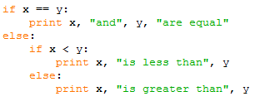
Nested Conditionals
One conditional can also be nested within another.
The outer conditional contains two branches. The first branch contains a simple output statement.
The second branch contains another if statement, which has two branches of its own.
Although the indentation of the statements makes the structure apparent, nested conditionals become difficult to read very quickly.
In general, it is a good idea to avoid them when you can.

Slide 10



Logical Operators Again
Logical operators often provide a way to simplify nested conditional statements.
The print statement is executed only if we make it past both the conditionals, so we can use the and operator in one conditional statement:
These kinds of conditions are common, so Python provides an alternative syntax that is similar to mathematical notation:

Slide 11
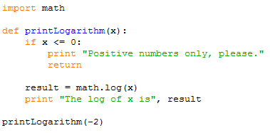
Return Statement
The return statement allows you to terminate the execution of a function before you reach the end. One reason to use it is if you detect an error condition:
When the return statement is executed the flow of execution immediately returns to the caller, and the remaining lines of the function are not executed.

Slide 12

Keyboard input
Python provides built-in functions that get input from the keyboard. The simplest is called raw_input which returns what the user types as a string.
The message telling the user what to input is called a prompt and is supplied as an argument to raw_input:
This function can be used to get other data types such as integer, but we need to convert the string to that data type first.

Slide 13


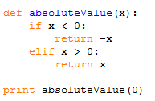
Fruitful Functions
Functions can be defined to return values.
The function below returns the perimeter of a circle with the given radius:
In a fruitful function the return statement includes a return value.
We can have multiple return statements, one in each branch of a conditional, but only one will be executed:
The function below does not provide a return statement when x happens to be 0. In this case, the return value is a special value called None:

Slide 14
Program Development
The goal of incremental development is to avoid long debugging sessions by adding and testing only a small amount of code at a time.
When testing a function, it is useful to know the right answer.
The key aspects of the process are:
1. Start with a working program and make small incremental changes. At any point, if there is an error, you will know exactly where it is.
2. Use temporary variables to hold intermediate values so you can output and check them.
3. Once the program is working, you might want to remove some of the scaffolding or consolidate multiple statements into compound expressions, but only if it does not make the program difficult to read.

Slide 15

Composition
We can call one function from within another. This ability is called composition.
By the Pythagorean theorem, the distance between two points, given by the coordinates (x1, y1) and (x2, y2) is:
Write a function that takes two points, the center of the circle and a point on the perimeter, and computes the perimeter of the circle.
The first step is to find the radius of the circle, which is the distance between the two points. radius = distance(xc, yc, xp, yp)
The second step is to find the perimeter of a circle with that radius and return it: result = perimeter(radius)

Slide 16



Boolean Functions
Functions can return Boolean values, which is often convenient for hiding complicated tests inside functions.
The name of this function is isDivisible. It is common to give Boolean functions names that sound like yes/no questions.
The condition of the if statement is itself a Boolean expression. We can return it directly, avoiding the if statement altogether:
Boolean functions are often used in conditional statements:

